Slide 1
Natural Language Processing
James Keenan

Slide 2
Overview
Introduction
History
Practical uses of NLP
Speech Recognition
Understanding
Grammar Rule-based Natural Language Processing
Statistical/Machine Learning Natural Language Processing
Future developments

Slide 3
Introduction
Natural language processing is an area of artificial intelligence concerned with the interactions between humans and computers using natural human languages.
Goal: Allow humans to accurately and effectively communicate with a computer using human language, and allow computers to communicate with humans using our language.
Wide and varied field of AI with many applications and uses.
Increasingly common in everyday life:
Virtual Assistants
Machine Translation
Suggestive Keyboards
Speech-to-text

Slide 4
Early History
Theory dates back to the 17th century
First patents awarded for ‘translating machines’ in 1930s
One such machine was a simple bilingual dictionary encoded on paper tape

Slide 5
History
Alan Turning proposed the Turing Test in the 1950s
Involves the ability of a computer to impersonate a human in a real-time conversation
MIT held a conference of the leading researchers in the field of machine translation in 1952
Resulted in Georgetown-IBM experiment in 1954
1957: Noam Chomsky’s Universal Grammar
Rule-based approaches dominant
Statistical Revolution of the 1980s
Breakthrough for NLP and Artificial Intelligence as a whole

Slide 6
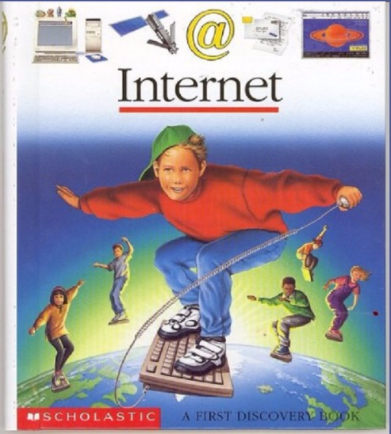
Recent History
1990s: Internet & Chat Bots
2006: Google releases Google Translate, their online machine translation service
Siri introduced in 2011 with the iPhone 4S
Also in 2011: IBM’s Watson wins $1 million on Jeopardy!
Virtual Assistants today: Siri, Google Assistant, Cortana, Bixby, Alexa and more!

Slide 7
Practical Uses of NLP
Speech Recognition
Convert spoken human language into text data useable for a computer
Critical for virtual assistants
Speech-to-text
Uses SR algorithms to transcribe spoken words into text, often in real time
Convenience features like hands-free text messaging and voicemail transcription
Disabilities
Hands free typing
Phone call transcription
Text-to-speech

Slide 8
Practical Uses of NLP
Natural Language Understanding
Figure out what a string of text in human language means
Machine Translation
Translate human language from one language to another while preserving intended meaning
Google Translate
Name Entity Recognition
Extract proper nouns from raw text data

Slide 9
Practical Uses of NLP
Word Segmentation
Given raw text, separate into individual words
Easy in English because we use spaces between words, but some languages (i.e. Japanese) do not delimit individual words
Word-sense Disambiguation
Read vs. Read
Hours vs. ours

Slide 10
Practical Uses of NLP
Automatic Summarization
Provide a summary of a text in a readable, understandable way
Relationship extraction
Given a chunk of text, determine the relationships between entities mentioned
Part of Speech Tagging
Determine if a word is a noun, verb, pronoun, etc.

Slide 11
Practical Uses of NLP
And so much more!
This is a HUGE field of AI.
We will focus on the NLP used for Virtual Assistants like Siri and Alexa
Need to:
Use speech recognition to translate spoken words into text
Determine meaning from the transcribed speech
Provide a useful response

Slide 12
Speech Recognition
Processes spoken human language into data in a form that is understandable to a computer
First step for virtual assistants like Siri when processing a new command
Typically uses Hidden Markov Models
Statistics-based approach
Not always the case, but by far the most commonly used option

Slide 13
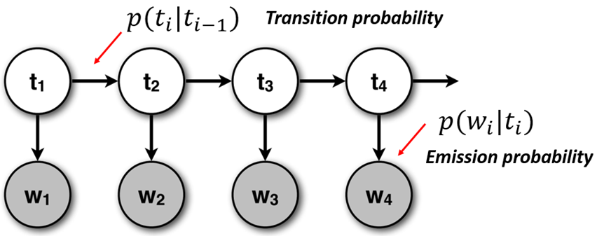
Speech Recognition – HMMs
In the speech recognition HMM, states are phonemes in individual words and states advance sound by sound.
By stringing these word HMMs together, input speech can be translated into sentences of text one word at a time.
Humans generally don’t pause between words when speaking. Input speech waveform is broken down into very small parts
Typically around 20 to 40 milliseconds
Each partition is compared to known phonemes, or parts of words, to transform acoustic signals into textual data.

Slide 14
Speech Recognition – HMM disadvantages
Speech Recognition HMMs can be several gigabytes in size
Serious problem on devices with limited storage like smartphones
Siri supports 41 languages/dialects – that’s a lot of data!
As a result, SR processing is not typically done locally but instead at remote data centers
Internet connection thus typically required for mobile devices
Serious problem when Siri was introduced in 2011 as the iPhone did not yet support LTE networks

Slide 15
Speech Recognition – HMM alternatives
Dynamic Time Warping
Early SR attempt that was superseded by HMM-based approaches
Attempted to match similarities in spoken sentences even if they varied in speed
End-to-End SR
Emerging technique currently in its infancy
Attempt to learn all components of speech together, not just work phoneme-by-phoneme like HMMs do.
More on this later

Slide 16
Natural Language Understanding
Virtual assistants like Siri still need to be able to understand the meaning of what was said to give a useful response.
Natural Language Understanding algorithms take the output of SR algorithms and try to figure out what we want!

Slide 17
Grammar Rule-Based Systems
Use hard-coded sets of grammar rules to determine meaning
Requires skilled linguists to develop rules
Predate statistical-based NLP solutions
Rule-based would be the focus of NLP research up until the statistical revolution of the ‘80s
Behaves similarly to parsers in programming languages, but for human languages instead
Human languages are much less structured than programming languages

Slide 18
Rule-Based NLU -- Disadvantages
Highly skilled linguists can be costly!
Needed for both initial development and maintenance of a rule-based NLP system
Will always follow its hard-coded rules, cannot “guess” meaning
No notion of inference
Quality of the NLP depends exclusively on the quality of the rules
Rules will not self-improve over time
Human languages are complicated!
Rule sets can become so large and so complex that rules begin to contradict each other

Slide 19
Rule-Based NLU -- Advantages
Always know what you're going to get
The system either has a rule that matches the input and can satisfy the request, or it does not and it won’t.
Do not need large sets of annotated training data like statistical-based models (more on that shortly)
Less likely to have incorrect results (when an applicable rule exists)
Can’t make a bad inference

Slide 20
Statistical Machine Learning NLU
Aims to develop an understanding of natural language without the need for hard-coded rules
Make use of statistical models which analyze a training data corpus in order to create their own knowledge base
This data is annotated with correct solutions and is used to make inferences that can be used in real-world operation

Slide 21
Statistical NLU -- Disadvantages
Requires a very large training corpus to make accurate inferences
Gathering and annotating this training data is hard work
Can make bad inferences from training data
Training data must very diverse
Can be very difficult to debug
Tracing back the source of bad inferences from such a huge training corpus is difficult
Bugs could be from your training data or from your code (or both)
Butterfly effect

Slide 22
Statistical NLU -- Disadvantages
Google Translate
Introduced in 2006, used statistical NLP for translation (until recently)
Franz Joseph Och – head of translation group until 2014
Training Corpora:
Bilingual text of 150 to 200 million words
Two monolingual texts of each more than one billion words (!)
Used transcripts of UN General Assembly and EU parliament meetings
Works Great! (If you speak a language spoken in Europe…)
2010 study: English->French translations much better than English->Chinese on Google Translate…
The source of training data effects the quality of the entire model: primary disadvantage of statistical models

Slide 23
Statistical NLU -- Advantages
Flexible
Inference! Probability! Unlike rule-based systems, statistical models can ‘guess’ on a tricky input and are much more tolerant of errors.
Hugely beneficial for human language
No need to employ highly skilled linguists
No need to design huge sets of grammar rules
Quality of the model can improve over time
Have become widely used since the 1980s

Slide 24
The Future

Slide 25
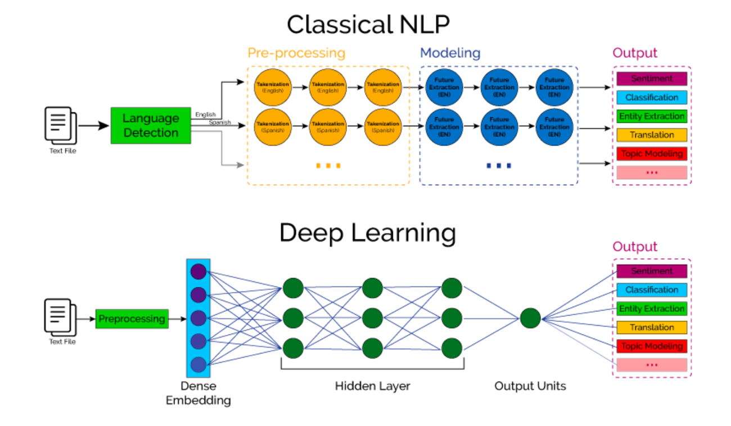
The Future
Deep Learning
Deep Neural Networks have become widespread since 2010
Attempts to learn in an end-to-end manner rather than a pipeline of separate tasks
Seen as a new paradigm beyond statistical NLP solutions like HMMs

Slide 26
The Future
Speech Recognition
Lots of interest in an “end-to-end” solution
HMMs struggle to cope with accents and other deviations from normal speech
End-to-end systems like neural networks have the potential to reduce the amount of training needed, improve the accuracy of transcriptions, and generally make speech recognition much better
Much smaller in size than HMMs, opening the possibility of localized SR processing
Still in early stages

Slide 27
The Future
Google Neural Machine Translation
Remember that I said statistical NLP was used for Google Translate until recently?
Deep learning, neural network solution for machine translation
End-to-end framework learns over time to create better and more accurate translations
Able to translate whole sentences at a time instead of working piece by piece
Began rollout in 2016 (the future is now!)
Zero-shot translation

Slide 28
Conclusion
Introduction
History
Practical uses of NLP
Speech Recognition
Understanding
Grammar Rule-based Natural Language Processing
Statistical/Machine Learning Natural Language Processing
Future developments

